Slide 1
Quiz Sustainable Development Goals

Slide 3
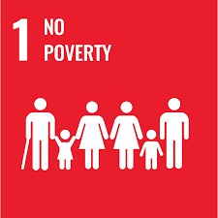
In 1990, almost 2 billion people lived in extreme poverty, i.e. on less than US$ 1.9 a day.
QUESTION 1
Approximately how many people lived in extreme poverty in 2023?

Slide 4
In 1990, almost 2 billion people lived in extreme poverty, i.e. on less than US$ 1.9 a day.
QUESTION 1
Approximately how many people lived in extreme poverty in 2023?
685 million
2,0 billion
2,8 billion

Slide 5
In 1990, almost 2 billion people lived in extreme poverty, i.e. on less than US$ 1.9 a day.
QUESTION 1
Approximately how many people lived in extreme poverty in 2023?
685 million people
Notes:
I følge Røde Kors

Slide 7
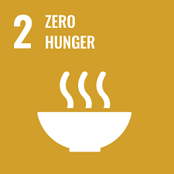
QUESTION 2
About 10% of the world's population suffers from malnutrition.
In which part of the world do most malnourished people live?

Slide 8
About 10% of the world's population suffers from malnutrition.
QUESTION 2
In which part of the world do most malnourished people live?
South America
Africa
Asia

Slide 9
About 10% of the world's population suffers from malnutrition.
QUESTION 2
In which part of the world do most malnourished people live?
Asia
Notes:
Per 2023 lider omtrent 9,2 prosent av verdens befolkning av underernæring, ifølge Food and Agriculture Organization (FAO). Dette betyr at nærmere 735 millioner mennesker globalt mangler tilstrekkelig ernæring. Tallene kan variere litt avhengig av kilder og metodikk brukt for å måle underernæring.
Flest underernærte mennesker bor i Asia, spesielt i Sør-Asia. India, Pakistan, og Bangladesh er blant landene med høyest antall underernærte mennesker. Afrika sør for Sahara har også en betydelig andel av befolkningen som lider av underernæring, men i absolutte tall er antallet høyest i Asia.

Slide 10
Sundhed og trivsel

Slide 11
QUESTION 3
In 1960, the average life expectancy in the world was 52 years.
What was the average life expectancy of the world's population in 2023?

Slide 12
In 1960, the average life expectancy in the world was 52 years.
QUESTION 3
What was the average life expectancy of the world's population in 2023?
55 years
63 years
73 years

Slide 13
In 1960, the average life expectancy in the world was 52 years.
QUESTION 3
What was the average life expectancy of the world's population in 2023?
73 years

Slide 14
kvalitetsuddannelse

Slide 15
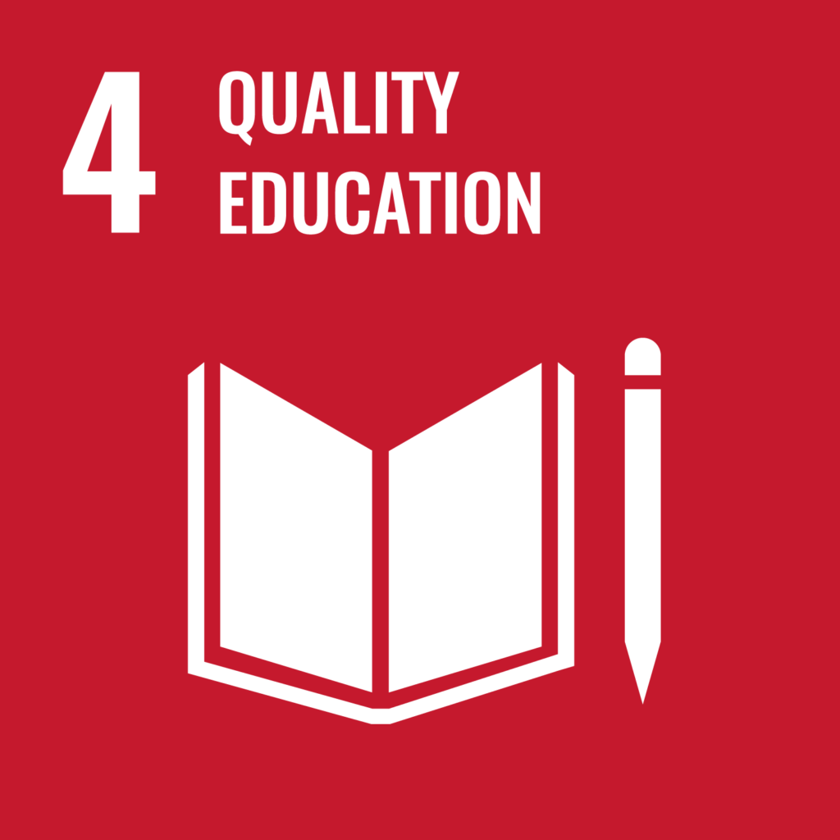
QUESTION 4
In 1980, approximately 44% of the world's population was illiterate.
Approximately what proportion of the world's population was illiterate in 2023?

Slide 16
In 1980, approximately 44% of the world's population was illiterate.
QUESTION 4
Approximately what proportion of the world's population was illiterate in 2023?
5 %
13 %
35 %

Slide 17
In 1980, approximately 44% of the world's population was illiterate.
QUESTION 4
Approximately what proportion of the world's population was illiterate in 2023?
13 %
Notes:
I 2023 var rundt 14% av verdens befolkning analfabeter. Dette tilsvarer omtrent 773 millioner voksne. Analfabetisme er mest utbredt i Sør-Asia og Afrika sør for Sahara, hvor utdanningssystemer ofte er underfinansierte og der mange barn, spesielt jenter, ikke fullfører grunnskolen.

Slide 18
Ligestilling mellem kønnene

Slide 19
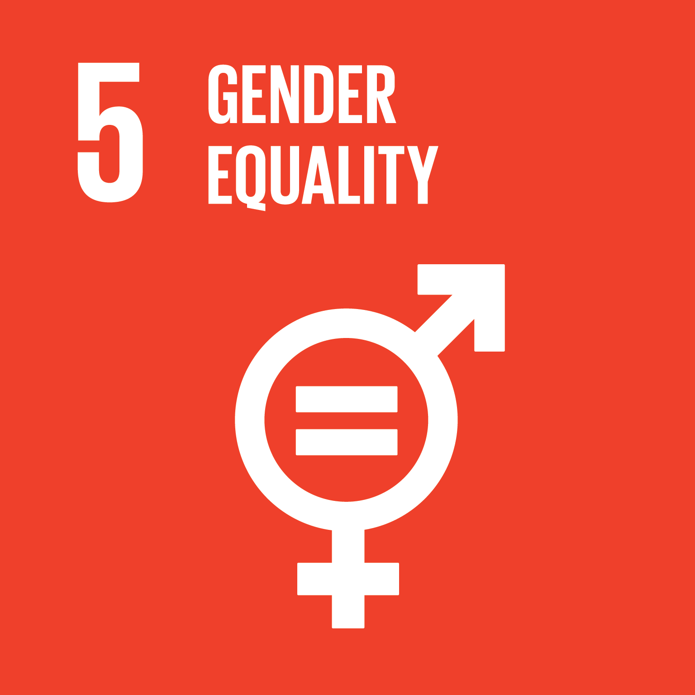
QUESTION 5
Norway got its first female mayor in 1926.
How many of the country's 428 mayors were women after the municipal elections in 2019?

Slide 20
Norway got its first female mayor in 1926.
QUESTION 5
How many of the country's 428 mayors were women after the municipal elections in 2019?
80
126
220

Slide 21
Norway got its first female mayor in 1926.
QUESTION 5
How many of the country's 428 mayors were women after the municipal elections in 2019?
126
Notes:
Etter kommunevalget i 2019 var 126 av landets 428 ordførere kvinner. Dette utgjør omtrent 29,4 % av ordførerne.

Slide 22
Score?

Slide 23
Rent vand og sanitet

Slide 24
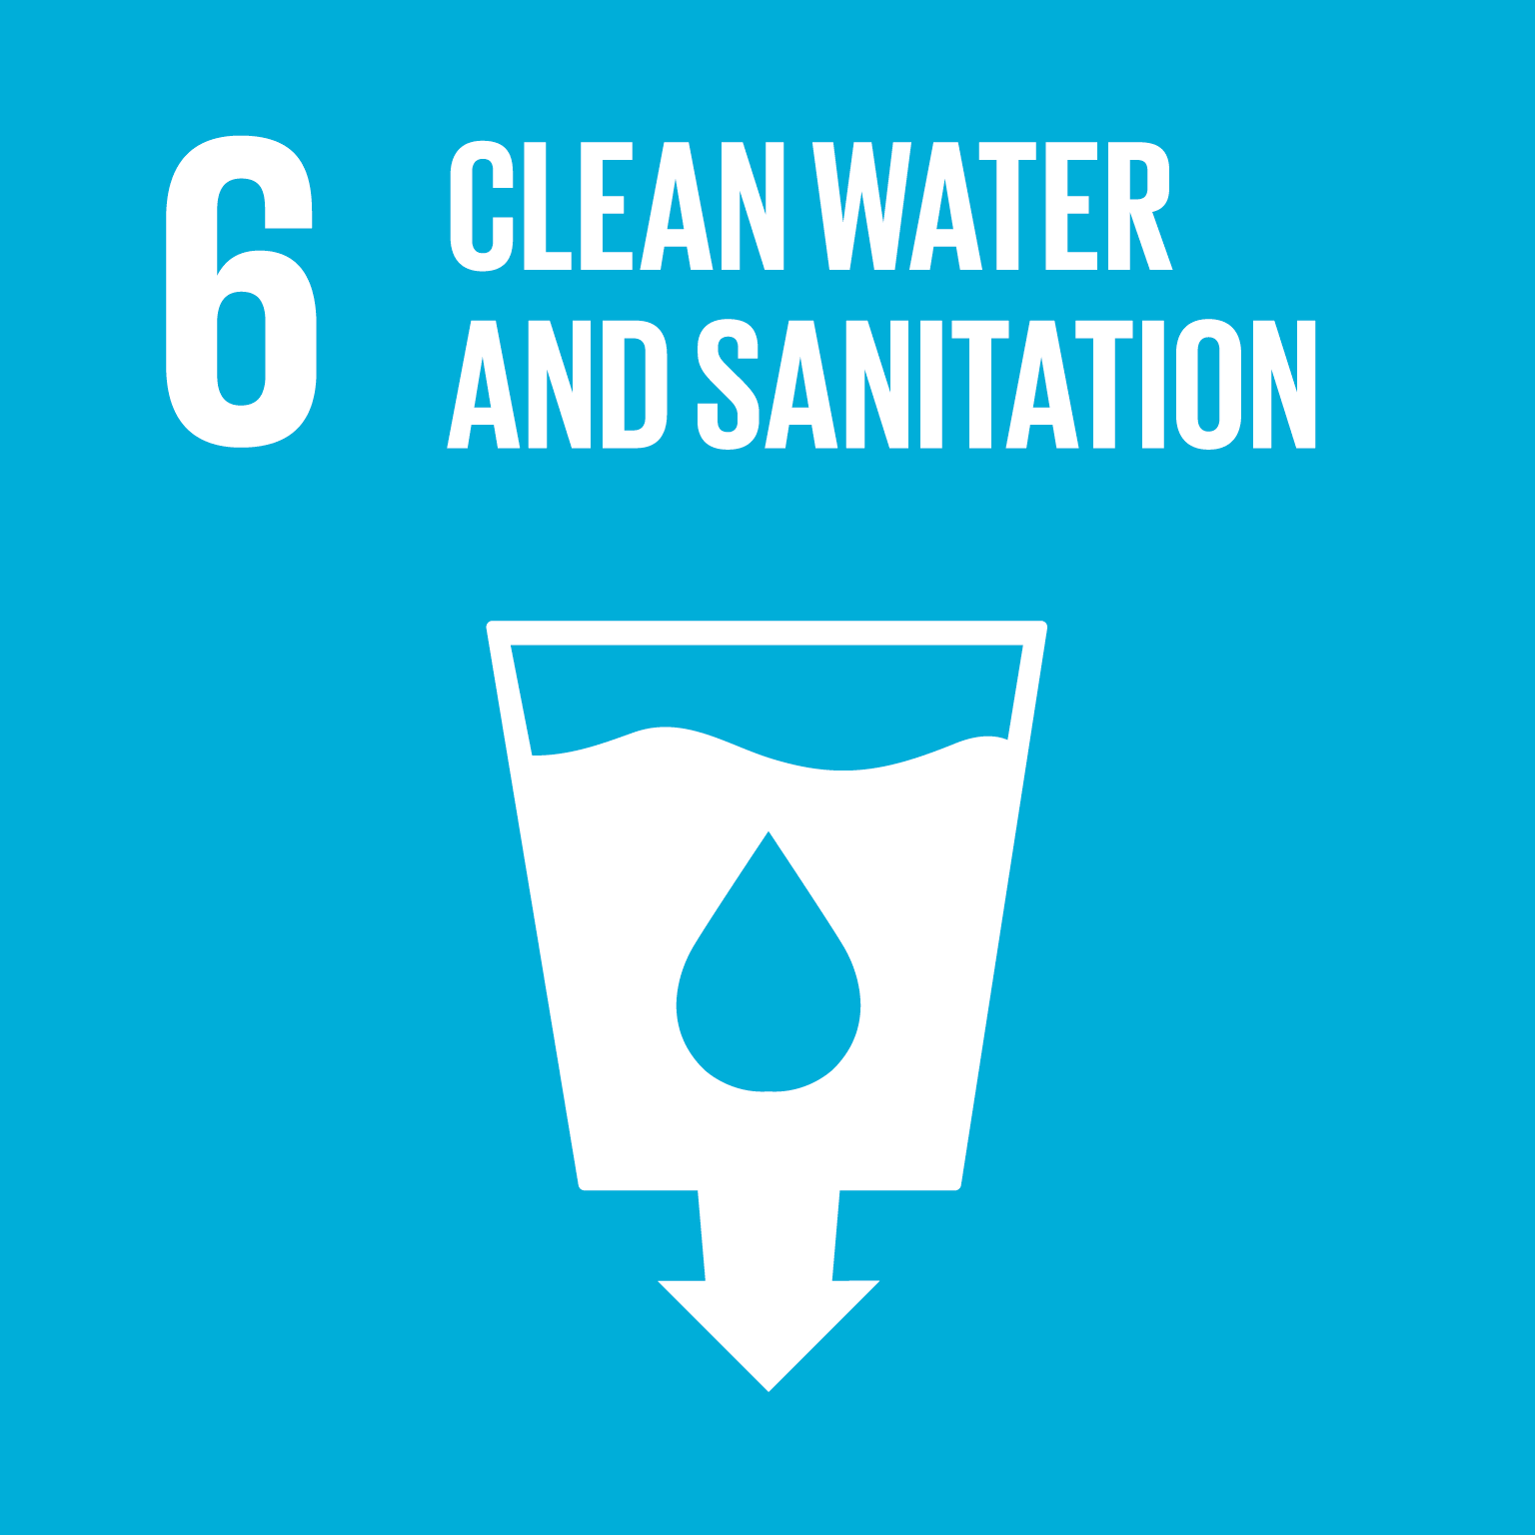
Thanks to efforts over time, 73% of the world's population had access to clean drinking water by 2023.
QUESTION 6
But how many people in the world do not have access to safe toilet conditions?

Slide 25
Thanks to efforts over time, 73% of the world's population had access to clean drinking water by 2023.
QUESTION 6
But how many people in the world do not have access to safe toilet conditions?
Less than 0,5 billion
Over 3,5 billion
1 billion

Slide 26
Thanks to efforts over time, 73% of the world's population had access to clean drinking water by 2023.
QUESTION 6
But how many people in the world do not have access to safe toilet conditions?
Over 3,5 billion people
Notes:
As of 2023, approximately 3.5 billion people in the world lack access to safely managed sanitation services, which includes access to a toilet or latrine that ensures proper treatment or safe disposal of excreta​ (World Health Organization (WHO))​.

Slide 27
Bæredygtig energi

Slide 28
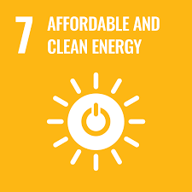
QUESTION 7
Hydropower accounts for 90% of Norway's power production.
Approximately how many hydropower plants are there in Norway?

Slide 29
Hydropower accounts for 90% of Norway's power production.
QUESTION 7
Approximately how many hydropower plants are there in Norway?
500
1 000
1 800

Slide 30
Hydropower accounts for 90% of Norway's power production.
QUESTION 7
Approximately how many hydropower plants are there in Norway?
1 800

Slide 31
Anstændige jobs og økonomisk vækst

Slide 32
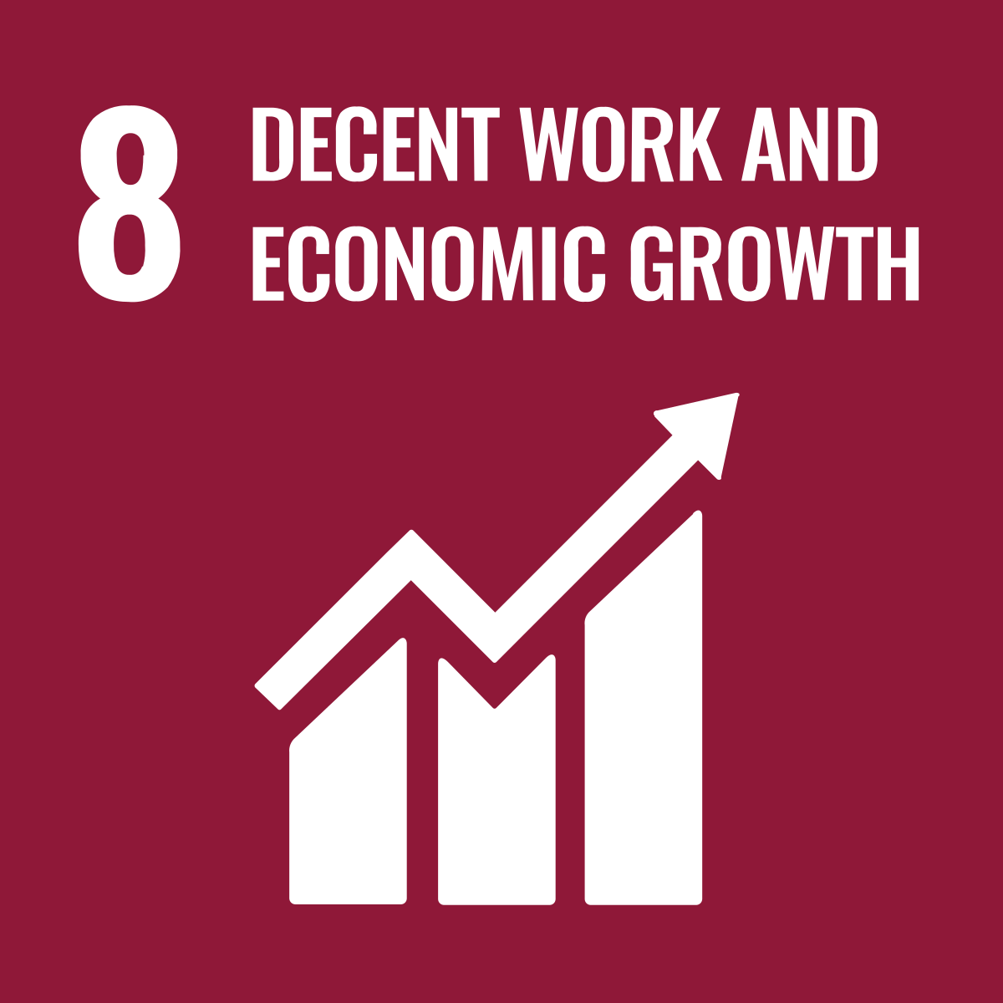
The fight against child labor is high on the political agenda. In the year 2000, there were around 250 million child workers in the world.
QUESTION 8
Approximately how many child workers were there in the world in 2024?

Slide 33
The fight against child labor is high on the political agenda. In the year 2000, there were around 250 million child workers in the world.
QUESTION 8
Approximately how many child workers were there in the world in 2024?
160 million
250 million
350 million

Slide 34
The fight against child labor is high on the political agenda. In the year 2000, there were around 250 million child workers in the world.
QUESTION 8
Approximately how many child workers were there in the world in 2024?
160 million

Slide 35
Industri, innovation og infrastruktur

Slide 36
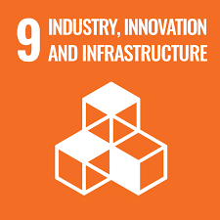
Norway is one of the countries where most residents are online - in fact as much as 97% per 2020. But this is not the case all over the world.
QUESTION 9
Approximately what proportion of the world's population had access to the internet in 2024?

Slide 37
Norway is one of the countries where most residents are online - in fact as much as 97% per 2020. But this is not the case all over the world.
QUESTION 9
Approximately what proportion of the world's population had access to the internet in 2024?
30 %
66%
70 %

Slide 38
Norway is one of the countries where most residents are online - in fact as much as 97% per 2020. But this is not the case all over the world.
QUESTION 9
Approximately what proportion of the world's population had access to the internet in 2024?
66 %

Slide 39
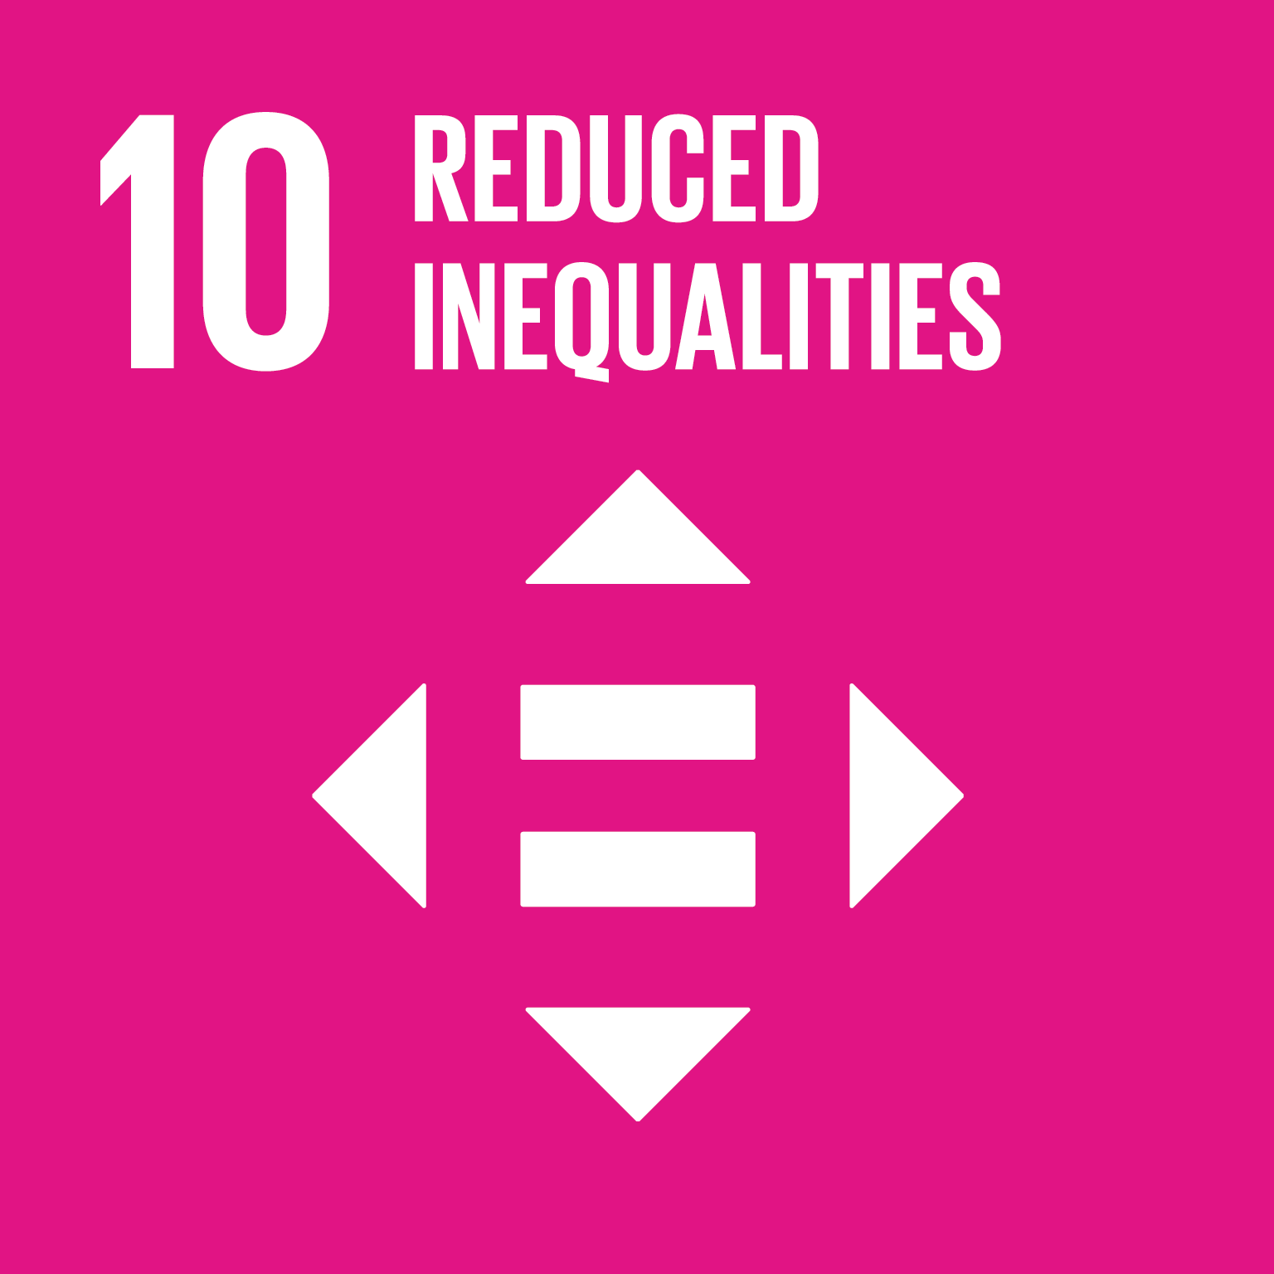
Mindre ulighed

Slide 40
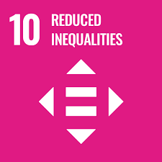
QUESTION 10
The gap between the world's richest and the world's poorest is increasing.
How much of the world's wealth does the world's richest 1% own?

Slide 41
The gap between the world's richest and the world's poorest is increasing.
QUESTION 10
How much of the world's wealth does the world's richest 1% own?
45 %
30 %
65 %

Slide 42
The gap between the world's richest and the world's poorest is increasing.
QUESTION 10
How much of the world's wealth does the world's richest 1% own?
45 % of the world’s wealth
Notes:
As of 2024, the richest 1% of the world's population owns approximately 45.8% of the global wealth. This concentration of wealth highlights the significant economic inequality present in the world today. While this small group holds nearly half of all wealth, the poorest 50% of the population collectively owns just 1.2%​ (Our World in Data)​​ (Inequality.org)​.

Slide 43
Score?

Slide 44
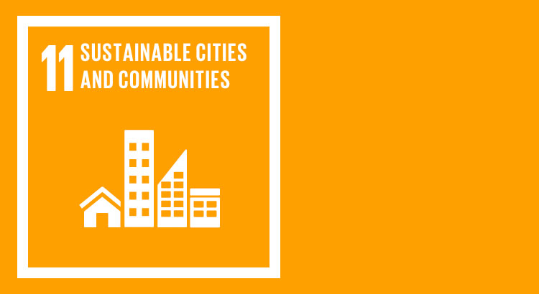
Bæredygtige byer og lokalsamfund

Slide 45
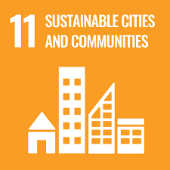
There is increasing political will to phase out diesel cars in city traffic, as they have a high emission of NOx gases.
QUESTION 11
Which two elements are included in a NOx gas?

Slide 46
There is increasing political will to phase out diesel cars in city traffic, as they have a high emission of NOx gases.
QUESTION 11
Which two elements are included in a NOx gas?
Neon and osmium
Nitrogen and oxygen
Nickel and xenon

Slide 47
There is increasing political will to phase out diesel cars in city traffic, as they have a high emission of NOx gases.
QUESTION 11
Which two elements are included in a NOx gas?
Nitrogen og oxygen

Slide 48
Ansvarligt forbrug og produktion

Slide 49
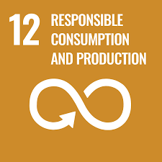
According to the Ministry of the Environment, Norway throws away 450,000 tonnes of food annually, which corresponds to approx. 85 kg per consumer.
QUESTION 12
Where does the biggest food waste take place?

Slide 50
According to the Ministry of the Environment, Norway throws away 450,000 tonnes of food annually, which corresponds to approx. 85 kg per consumer.
QUESTION 12
Where does the biggest food waste take place?
In households
In grocery stores
In restaurants

Slide 51
According to the Ministry of the Environment, Norway throws away 450,000 tonnes of food annually, which corresponds to approx. 85 kg per consumer.
QUESTION 12
Where does the biggest food waste take place?
In households

Slide 52
Klimaindsats

Slide 53
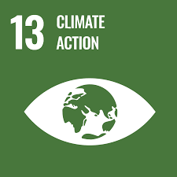
Global warming is closely linked to emissions of CO2.
QUESTION 13
Which of these countries emitted the most CO2 per capita in 2023?

Slide 54
Global warming is closely linked to emissions of CO2.
QUESTION 13
Which of these countries emitted the most CO2 per capita in 2023?
China
Qatar
Germany

Slide 55
Global warming is closely linked to emissions of CO2.
QUESTION 13
Which of these countries emitted the most CO2 per capita in 2023?
Qatar
Notes:
In 2023, Qatar had the highest CO2 emissions per capita among Qatar, China, and Germany. Specifically, Qatar's per capita emissions were significantly higher than those of China and Germany. This is largely due to Qatar's reliance on fossil fuels and its small population relative to its substantial hydrocarbon extraction activities.
Qatar: Approximately 35.6 tons of CO2 per capita.
China: Approximately 7.6 tons of CO2 per capita.
Germany: Approximately 7.8 tons of CO2 per capita​ (Our World in Data)​​

Slide 56
Livet i havet

Slide 57
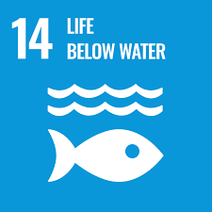
QUESTION 14
The so-called Great Pacific Garbage Patch is a large ocean area where plastic waste floats around and poses a threat to marine animals and ecosystems.
Approximately how big is it?

Slide 58
The so-called Great Pacific Garbage Patch is a large ocean area where plastic waste floats around and poses a threat to marine animals and ecosystems.
QUESTION 14
Approximately how big is it?
About the size of Spitsbergen
About the size of Norway
About the size of Mongolia

Slide 59
The so-called Great Pacific Garbage Patch is a large ocean area where plastic waste floats around and poses a threat to marine animals and ecosystems.
QUESTION 14
Approximately how big is it?
About the size of Mongolia

Slide 60
Livet på land

Slide 61
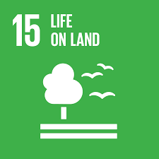
Sufficiently large forest areas are essential for the earth’s ecosystems.
QUESTION 15
What percentage of Norway is covered by forest?

Slide 62
Sufficiently large forest areas are essential for the earth’s ecosystems.
QUESTION 15
What percentage of Norway is covered by forest?
17 %
37 %
57 %

Slide 63
Sufficiently large forest areas are essential for the earth’s ecosystems.
QUESTION 15
What percentage of Norway is covered by forest?
37 %

Slide 64
Fred, retfærdighed og stærke institutioner

Slide 65
According to Transparency International, the following countries were the least corrupt in 2023.
QUESTION 16
Rank | Country | Score
1 | ????? | 90
2 | Finland | 87
3 | New Zealand | 85
4 | Norway | 84
5 | Singapore | 83
Which country is in first place?

Slide 66
According to Transparency International, the following countries were the least corrupt in 2023.
QUESTION 16
Rank | Country | Score
1 | ????? | 90
2 | Finland | 87
3 | New Zealand | 85
4 | Norway | 84
5 | Singapore | 83
Which country is in first place?
Sweden
Japan
Denmark

Slide 67
According to Transparency International, the following countries were the least corrupt in 2023.
QUESTION 16
Rank | Country | Score
1 | ????? | 90
2 | Finland | 87
3 | New Zealand | 85
4 | Norway | 84
5 | Singapore | 83
Which country is in first place?
Denmark

Slide 68
Partnerskaber for handling

Slide 69
QUESTION 17
In 2023, Norway and six other countries met the objective of donating a certain part of their gross national income to development aid.
What proportion of GNI is the target on?

Slide 70
In 2023, Norway and six other countries met the objective of donating a certain part of their gross national income to development aid.
QUESTION 17
What proportion of GNI is the target on?
0,2 %
0,7 %
1,2 %

Slide 71
In 2023, Norway and six other countries met the objective of donating a certain part of their gross national income to development aid.
QUESTION 17
What proportion of GNI is the target on?
0,7 %
Notes:
In 2023, six countries met or exceeded the target of donating 0.7% of their Gross National Income (GNI) to official development assistance (ODA). These countries were:
Luxembourg
Norway
Sweden
Germany
Denmark
United Kingdom

Slide 72
Thank you!
“We Are the First Generation that Can End Poverty, the Last that Can End Climate Change”
Ban Ki-moon UN General Secretary
2015

